Slide 1
Radial Basis Function Network
物理二 劉仲楷 (B10202012)

Slide 2
Outline
- RBF kernel and NN revisited
- RBF Network hypothesis and learning
- k-means algorithm

Slide 3
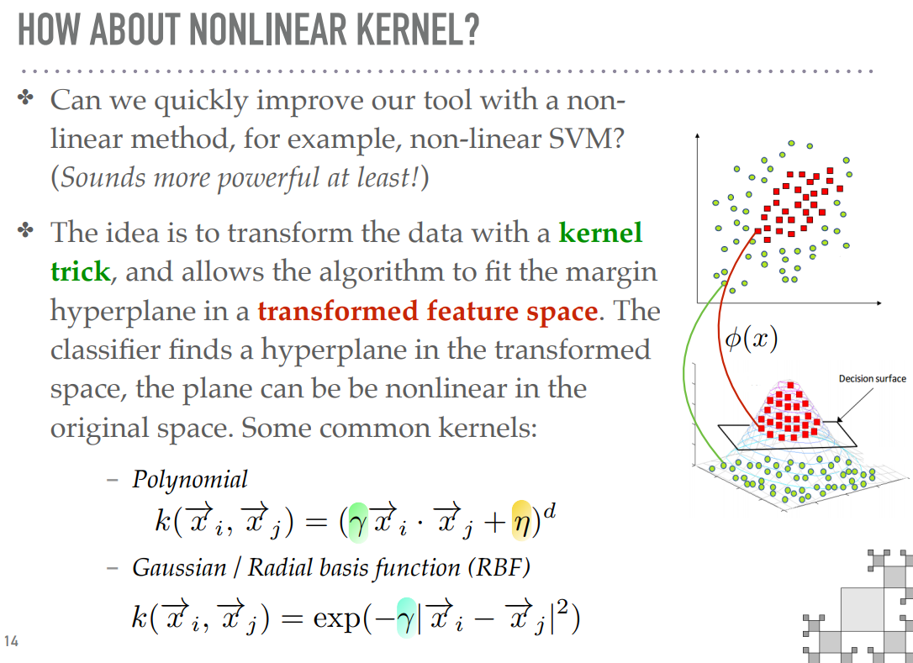
RBF Kernel Revisited

Slide 4
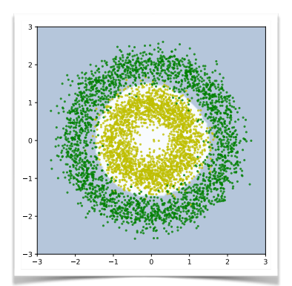
RBF Kernel Revisited

Slide 5
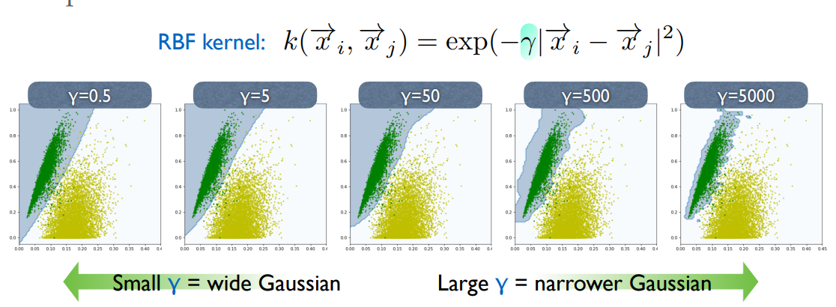
RBF Kernel Revisited

Slide 6
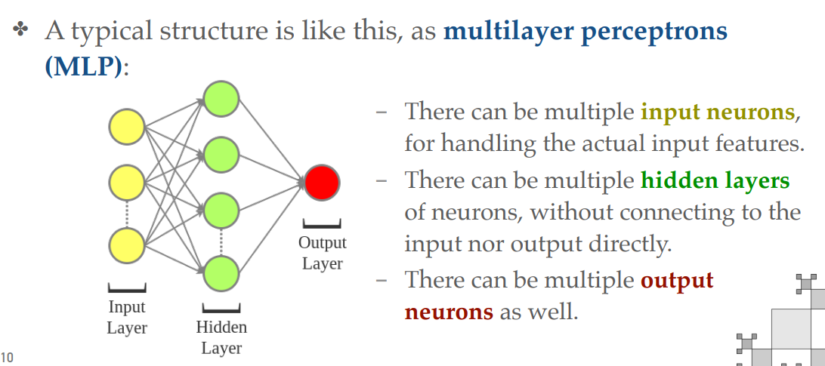
Neural Network Revisited

Slide 7
RBF Network
tanh
RBF
tanh
RBF
tanh
RBF
tanh
RBF

Slide 8

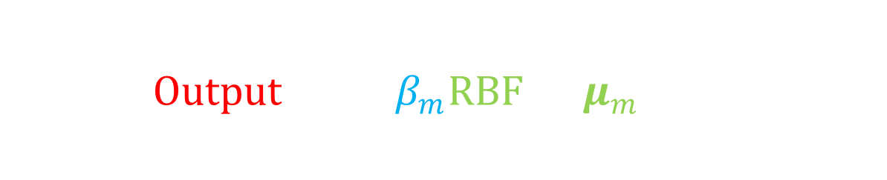
RBF Network Hypothesis
$$h\left(x\right)=Output\left(\sum_{m=1}^{M}{β_{m}RBF\left(x,μ_{m}\right)}\right)$$
New hyperparameters:
$weights β_{m}$
$centers μ_{m}$
Output: sign/sigmoid/none(regression)/…
RBF
RBF
RBF
RBF

Slide 9

RBF Network Learning: Full and Uniform
$$h\left(x\right)=Output\left(\sum_{m=1}^{M}{β_{m}RBF\left(x,μ_{m}\right)}\right)$$
Full RBF Network: $μ_{m}=x_{m}$
Uniform influence: $β_{m}= 1$
“Lazy” learning
RBF
RBF
RBF
RBF

Slide 10
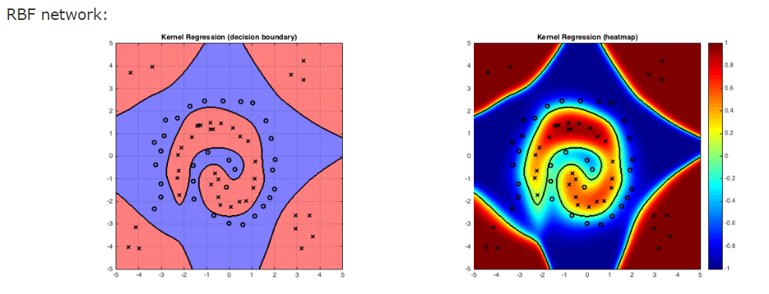
RBF Network Learning: Full and Uniform
$$h\left(x\right)=Output\left(\sum_{m=1}^{M}{β_{m}RBF\left(x,μ_{m}\right)}\right)$$
Full RBF Network: $μ_{m}=x_{m}$
Uniform influence: $β_{m}= 1$
“Lazy” learning
RBF
RBF
RBF
RBF

Slide 11

RBF Network Learning: k-Nearest Neighbor
$$h\left(x\right)=Output\left(\sum_{m=1}^{M}{β_{m}RBF\left(x,μ_{m}\right)}\right)$$
Full RBF Network: $μ_{m}=x_{m}$
kNN: $β_{m}=δ_{m,argmin(\left|x−x_{n}\right|)}$
“Lazier” learning
RBF
RBF
RBF
RBF

Slide 12
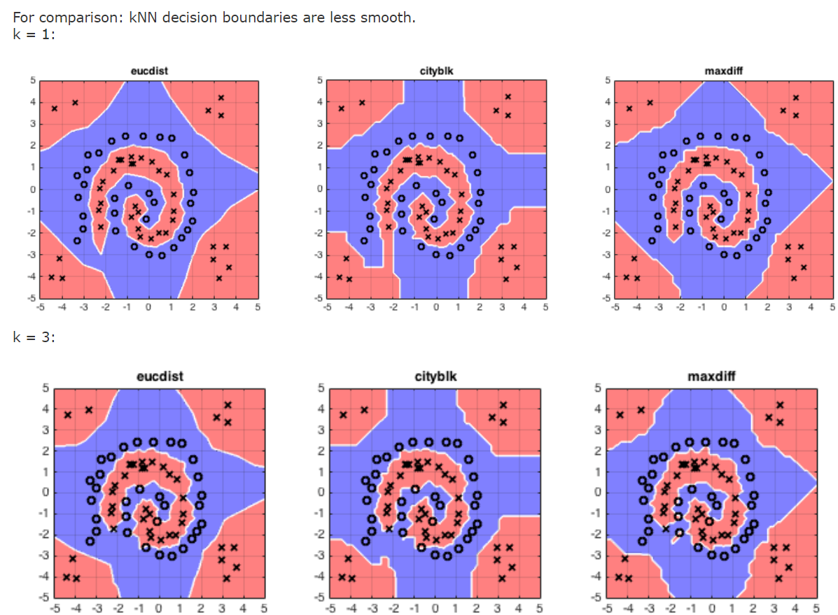
RBF Network Learning: k-Nearest Neighbor
$$h\left(x\right)=Output\left(\sum_{m=1}^{M}{β_{m}RBF\left(x,μ_{m}\right)}\right)$$
Full RBF Network: $μ_{m}=x_{m}$
kNN: $β_{m}=δ_{m,argmin(\left|x−x_{n}\right|)}$
“Lazier” learning
RBF
RBF
RBF
RBF

Slide 13

RBF Network Learning: Overfitting
$$h\left(x\right)=Output\left(\sum_{m=1}^{M}{β_{m}RBF\left(x,μ_{m}\right)}\right)$$
Strong hypothesis → Overfitting
Regularization! (Validation as well)
Full → few center $μ_{m}$
RBF
RBF
RBF
RBF

Slide 14

k-Means Algorithm
Full → few center $μ_{m}$
If $x_{1}≈x_{2}$, cluster RBF(x, $x_{1}$) and RBF(x, $x_{2}$) into RBF(x, $μ_{m}$)
Cluster into k groups which $μ_{m}≈x_{n} (x_{n}∈S_{m})$
Cluster error measure:
$$Loss=\frac{1}{N}\sum_{n=1}^{N}{\sum_{m=1}^{M}{\left[x_{n}∈S_{m}\right]{\left|x_{n}−μ_{m}\right|}^{2}}}$$

Slide 15

k-Means Algorithm
$$Loss=\frac{1}{N}\sum_{n,m}{\left[x_{n}∈S_{m}\right]{\left|x_{n}−μ_{m}\right|}^{2}}$$
Hard to optimize → alternatingly optimize two set variables
First of all, choosing number of group (k)

Slide 16

k-Means Algorithm
Initialize $μ_{m}$ (can randomly choose by $x_{n}$ )
Alternating optimization repeatedly
Fixed $μ_{m}$, choose $S_{m}$ for every $x_{n}$
$m= argmin ({\left|x_{n}−μ_{m}\right|}^{2})$
Fixed $S_{m}$, optimize each $μ_{m}$
$μ_{m}=avg(x_{n}∈S_{m})$
- can simply prove by $∇_{μ_{m}}Loss=0$

Slide 17

k-Means Algorithm
Initialize $μ_{m}$ (can randomly choose by $x_{n}$ )
Alternating optimization repeatedly
Fixed $μ_{m}$, choose $S_{m}$ for every $x_{n}$
$m= argmin ({\left|x_{n}−μ_{m}\right|}^{2})$
Fixed $S_{m}$, optimize each $μ_{m}$
$μ_{m}=avg(x_{n}∈S_{m})$
Until converge

Slide 19
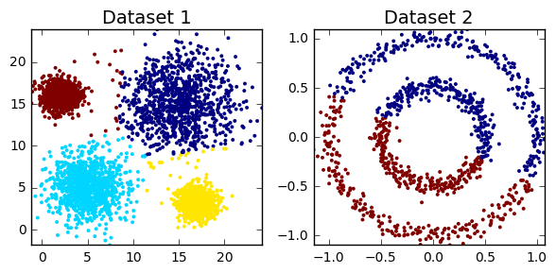
Difficulties of k-Means
k?
Local optima
Complex cluster

Slide 20

RBF with k-Means
Run k –means to get {$μ_{m}$}
Construct Network with activation function $RBF\left(x,μ_{m}\right)$
Optimize loss to get $β_{m}$ by regression, backpropagation,…
Finish!!!

Slide 21

Notes:
Func. approx., time series prediction

Slide 22
References
Lecture Module L3, L4
ML Tech. lecture 14 on MOOCs by prof. H. T. Lin
Clustering with Scikit with GIFs by dashee87.github.io
Wikipedia: RBF Network
https://www.cse.wustl.edu/~m.neumann/sp2016/cse517/lecturenotes/lecturenote13.html

